Slide 1
Bias errors in AI systems

Slide 2
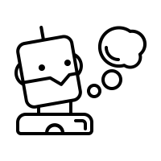
What are bias errors anyway?

Slide 3
What are bias errors anyway?
Distortion or Prejudice
→ arise when collecting the data necessary for the system
→ can lead to serious problems in the system and discrimination

Slide 4
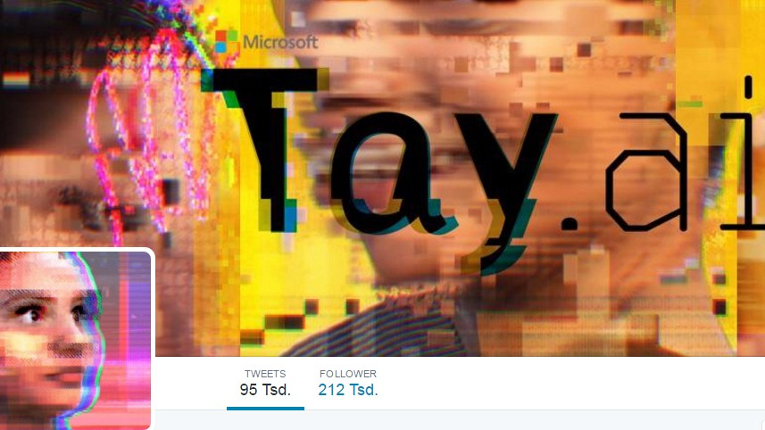
What are bias errors anyway?
Example: Chatbot Tay (2016)
Twitter chatbot that "learned" from real users' tweets
began posting discriminatory messages very quickly
→ after only 16 hours the chatbot was taken offline again

Slide 5
What types of bias errors are there?

Slide 6
What types of bias errors are there?
algorithmic AI bias or “data bias”: Bias error caused by data fed in (statistical distortion of the data)
societal AI bias: norms indoctrinated by society; but stereotypes also create blind spots or prejudices (social prejudices)

Slide 7
What types of bias errors are there?
algorithmic AI bias or “data bias”: Bias error caused by data fed in (statistical distortion of the data)
societal AI bias: norms indoctrinated by society; but stereotypes also create blind spots or prejudices (social prejudices)
→ Societal Bias beeinflusst/schafft häufig algorithmische Bias-Fehler!

Slide 8
Why do we need ethical rules for artificial intelligence?

Slide 9
Why do we need ethical rules for artificial intelligence?
Programmers can (unintentionally) build their own prejudices into programs
Ethical rules try to ensure that no one is excluded and discriminated against

Slide 10
Ethical guidelines for a trustworthy AI
Fairness
Respect for human autonomy
Protection from harm
Traceability

Slide 11
Fairness
protect against discrimination
equal opportunity
People must not be deceived
AI systems have to be transparent

Slide 12
Respect for human autonomy
Self-determination (I can decide about myself)
Living basic rights
AI systems are designed to empower and encourage people
Human oversight of AI systems

Slide 13
Protection from harm
AI must neither cause nor aggravate damage (mental and physical integrity)
AIs have to be technically robust
Consideration for vulnerable people (children, disabled people ...)
unequal distribution of power or information (e.g. state and citizens)

Slide 14
Traceability
Processes should be transparent
Beware of "black box algorithms" (it is not entirely clear here how a system comes to the respective result)

Slide 15
Watch out!
Sometimes these four areas cannot be combined!
E.g. "predictive police work" Special surveillance measures can then help in the fight against crime, but at the same time limit one's own freedom and data protection rights.

Slide 16
How can bias errors be avoided?

Slide 17
How can bias errors be avoided?
Self Reflection
Taking different perspectives: Do I catch myself thinking in stereotypes? Do I have prejudices against others?
2. Active communication
Do I notice something in a program? Do I feel excluded or discriminated against as a result? → address it directly

Slide 18
How can bias errors be avoided?
Self Reflection
Taking different perspectives: Do I catch myself thinking in stereotypes? Do I have prejudices against others?
2. Active communication
Do I notice something in a program? Do I feel excluded or discriminated against as a result? → address it directly
Do you have any other ideas?

Slide 19
Wie können Bias-Fehler vermieden werden?
Selbstreflexion
Einnehmen unterschiedlicher Perspektiven: Erwische ich mich bei Schubladendenken? Hab ich Vorurteile gegenüber anderen?
2. Aktive Kommunikation
Fällt mir etwas auf in einem Programm? Fühle ich mich dadurch ausgeschlossen oder diskriminiert? → direkt darauf ansprechen
Habt ihr noch weitere Ideen?

